Slide 1
Bidirectional Associative Memory
by
Greg
JST - Bidirectional Associative Memory

Slide 2
Hopfield Network Major Limitation
Hopfield network represents an auto-associative type of memory.
  Can retrieve a corrupted / incomplete memory
  Cannot associate a memory with another different memory
Human memory is essentially associative.
  One thing may remind us of another, and that of another, and so on.
  We use a chain of mental associations to recover a lost memory.
Why can’t a Hopfield network do this job?
  It is a single-layer network
    The output pattern appears on the same set of neurons to which the input pattern was applied.
JST - Bidirectional Associative Memory

Slide 3

Hopfield Network Major Limitation
Girlfriend
It need a RNN capable of accepting an input pattern on one set of neurons and producing a related, but different, output pattern on another set of neurons.
JST - Bidirectional Associative Memory

Slide 4
Bidirectional Associative Memory
Proposed by Bart Kosko.
  It is called Heteroassociative Network (Kosko, 1987, 1988).
It associates patterns from one set to another set and vice versa.
It can generalise and also produce correct outputs despite corrupted or incomplete inputs.
JST - Bidirectional Associative Memory

Slide 5
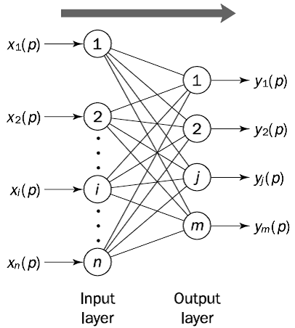
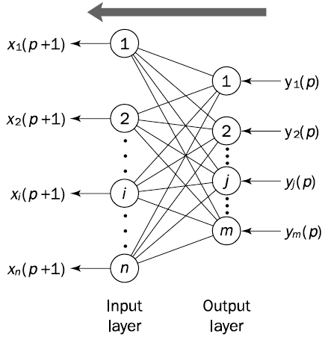
Bidirectional Associative Memory
JST - Bidirectional Associative Memory

Slide 6
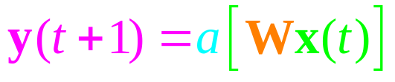
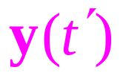
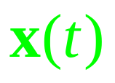
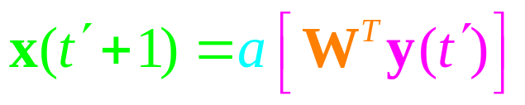
Bidirection Memory
y₁
y₂
y_{n}
Y Layer
. . .
Forward
Pass
Backward
Pass
. . .
W=[w_{ij}]_{n×m}
x₁
x₂
X Layer
x_{m}
JST - Bidirectional Associative Memory

Slide 7
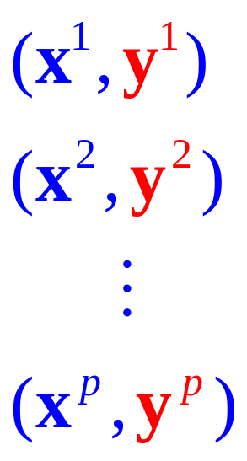
Bidirection Memory
Stored Patterns
y₁
y₂
y_{n}
Y Layer
. . .
?
Forward
Pass
Backward
Pass
. . .
W=[w_{ij}]_{n×m}
x₁
x₂
X Layer
x_{m}
JST - Bidirectional Associative Memory

Slide 8
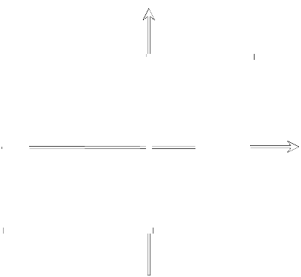
Bidirectional Associative Memory
Activation Function
  Sign Function
JST - Bidirectional Associative Memory

Slide 9
BAM Algorithm
Step 1: Storage
The BAM is required to store M pairs of patterns, X₁: Y₁, X₂:Y₂, . . . , X_{M}:Y_{M}.
The weight matrix is determined as:
JST - Bidirectional Associative Memory

Slide 10
BAM Algorithm
Step 2: Testing
The BAM should be able to receive any vector from set A and retrieve the associated vector from set B, and receive any vector from set B and retrieve the associated vector from set A. Thus, first we need to confirm that the BAM is able to recall Y_{m} when presented with X_{m}. That is,
Then, we confirm that the BAM recalls Xm when presented with Ym. That is,
JST - Bidirectional Associative Memory

Slide 11
BAM Algorithm
Step 3: Retrieval
Present an unknown vector (probe) X to the BAM and retrieve a stored association. The probe may present a corrupted or incomplete version of a pattern from set A (or from set B) stored in the BAM. That is,
X ≠ X_{m} , m = 1, 2, . . . ,M
(a) Initialise the BAM retrieval algorithm by setting
X(0) = X , p = 0
and calculate the BAM output at iteration p
Y(p) = sign [W^{T} X(p)]
(b) Update the input vector X(p):
X(p + 1) = sign [W Y(p)]
and repeat the iteration until equilibrium, when input and output vectors remain unchanged with further iterations. The input and output patterns will then represent an associated pair.
JST - Bidirectional Associative Memory

Slide 12
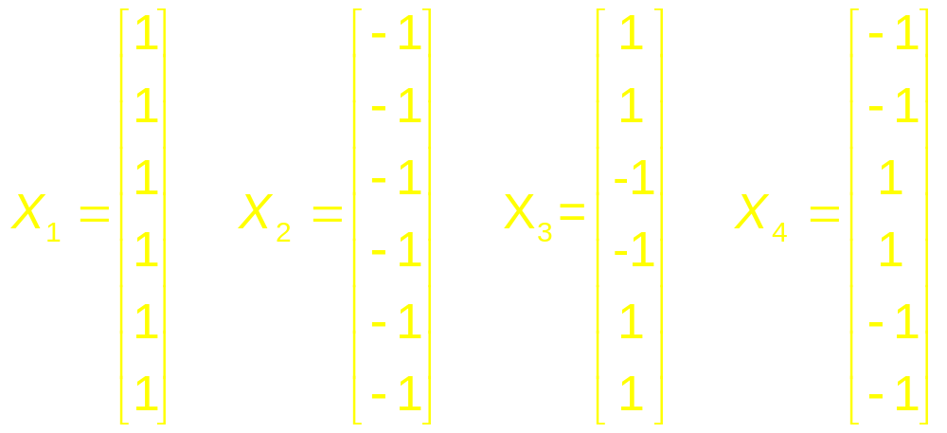
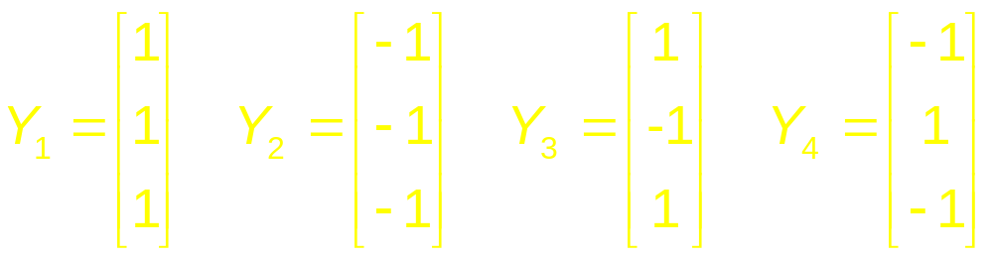
BAM Example
Example: 4 pattern
Set A:
Set B:
JST - Bidirectional Associative Memory

Slide 13
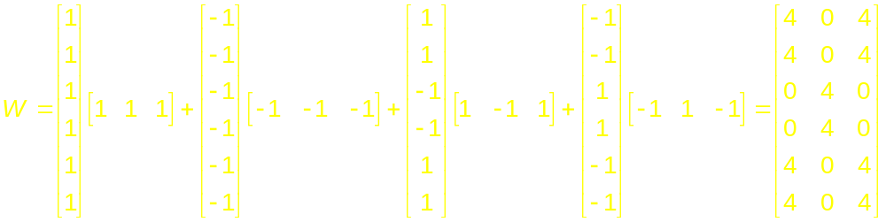
BAM Example
Step 1: Storage
JST - Bidirectional Associative Memory

Slide 14
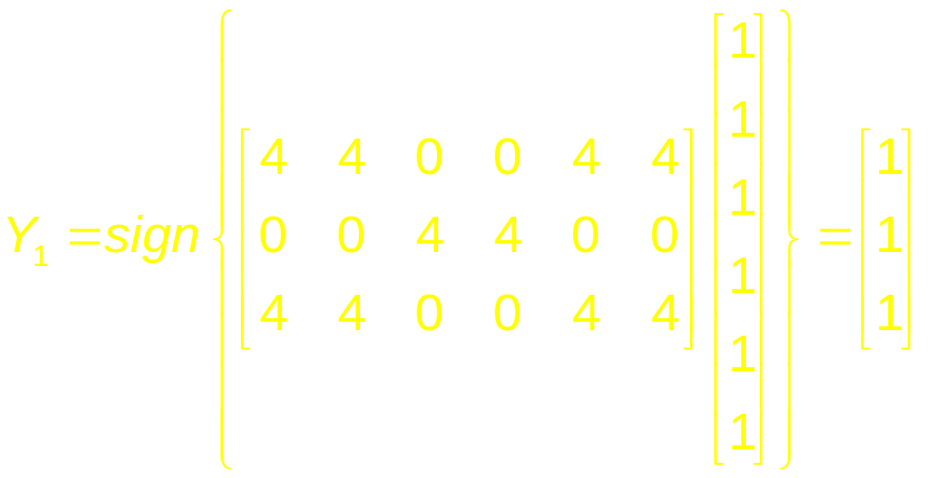
BAM Example
Step 2: Testing
JST - Bidirectional Associative Memory

Slide 15
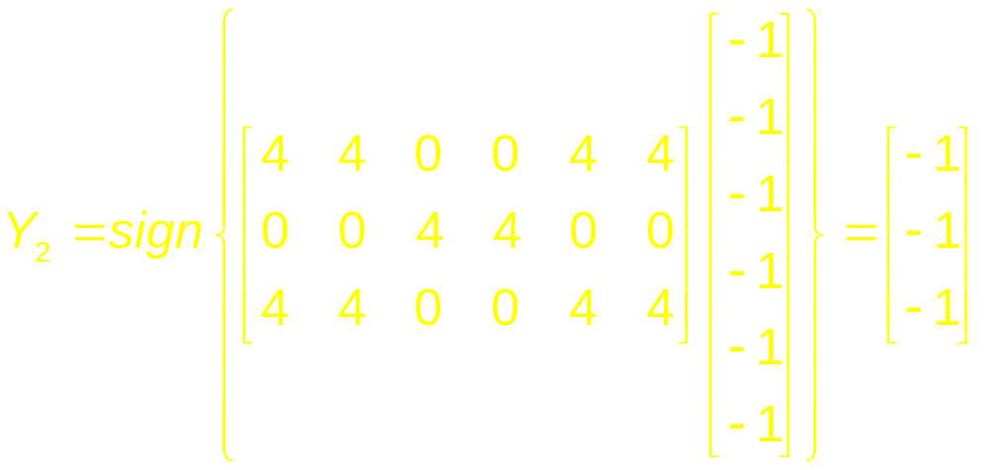
BAM Example
Step 2: Testing
JST - Bidirectional Associative Memory

Slide 16
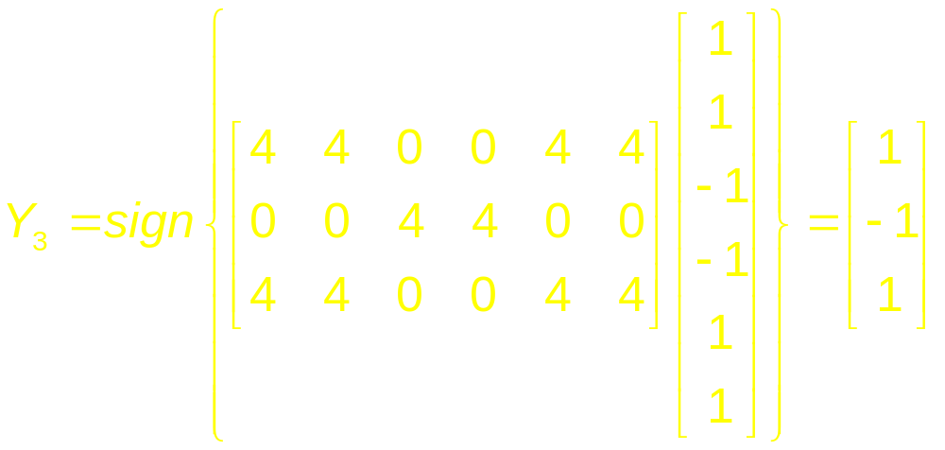
BAM Example
Step 2: Testing
JST - Bidirectional Associative Memory

Slide 17
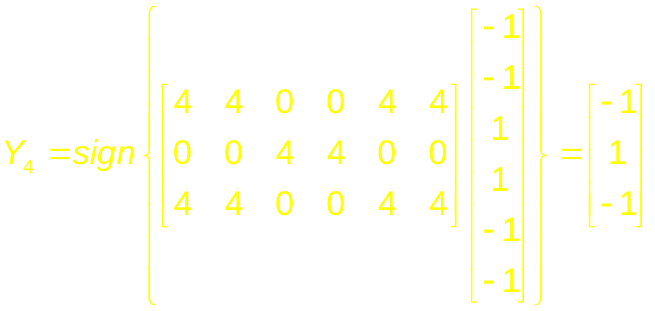
BAM Example
Step 2: Testing
JST - Bidirectional Associative Memory

Slide 18
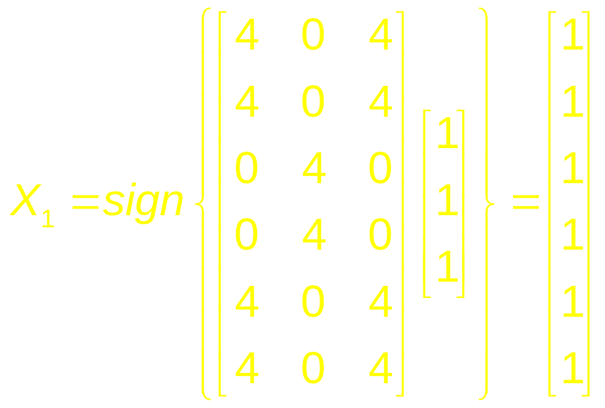
BAM Example
Step 2: Testing
JST - Bidirectional Associative Memory

Slide 19
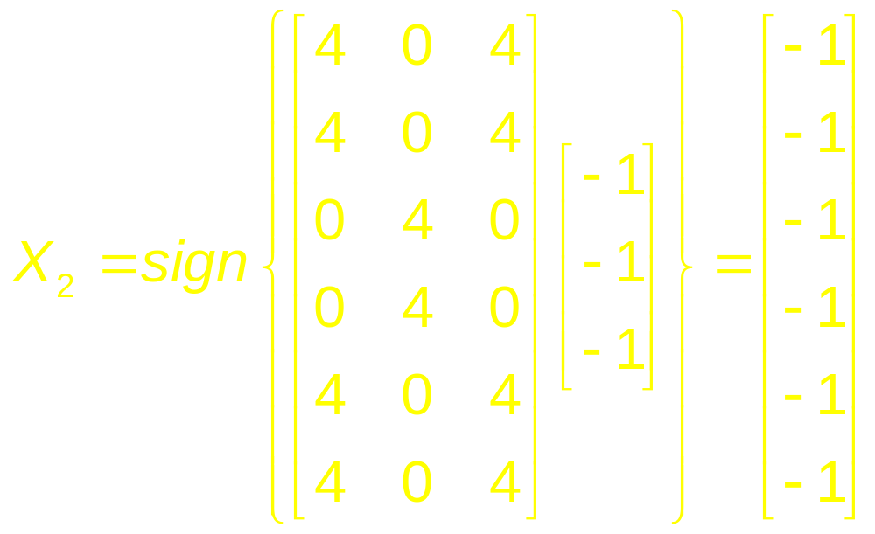
BAM Example
Step 2: Testing
JST - Bidirectional Associative Memory

Slide 20
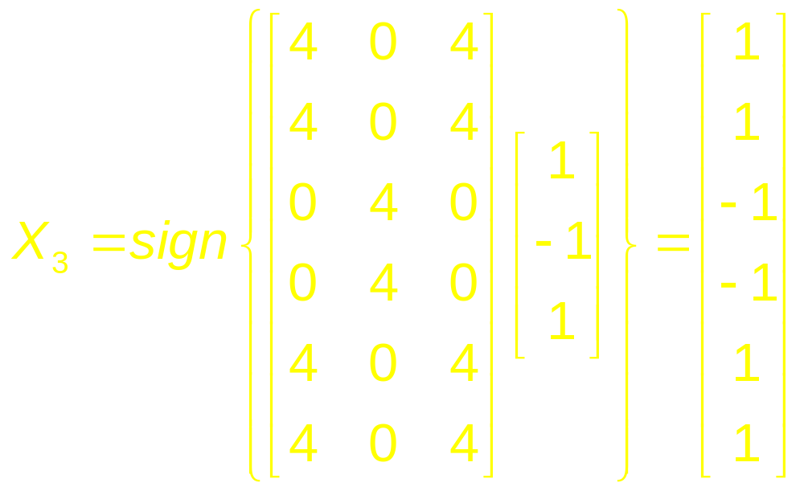
BAM Example
Step 2: Testing
JST - Bidirectional Associative Memory

Slide 21
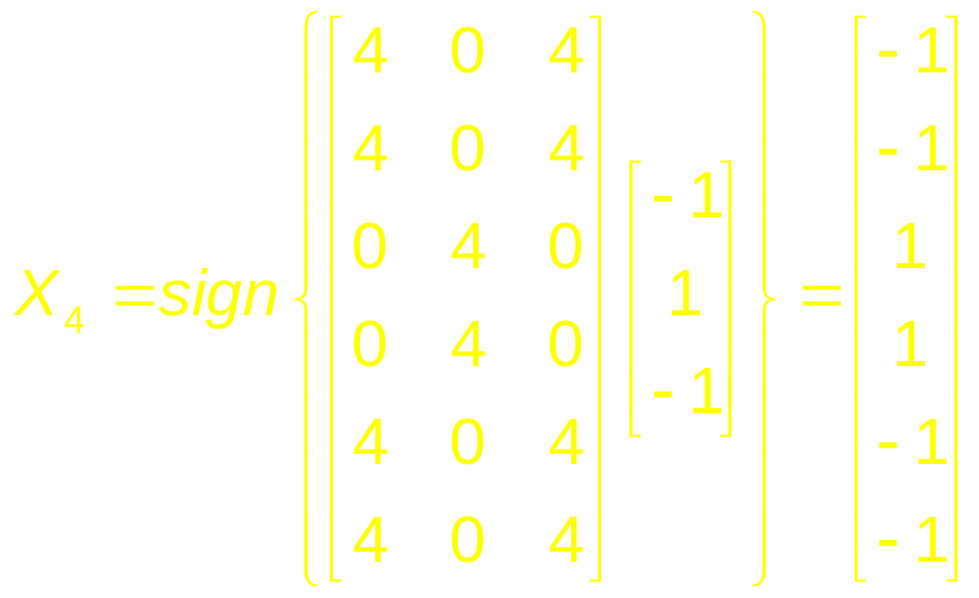
BAM Example
Step 2: Testing
JST - Bidirectional Associative Memory

Slide 22
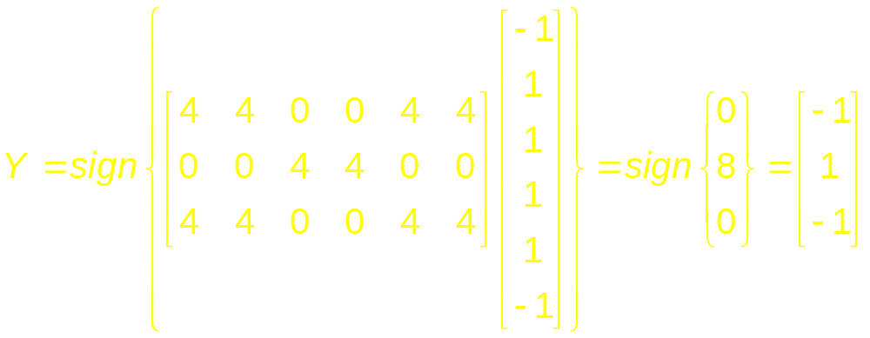
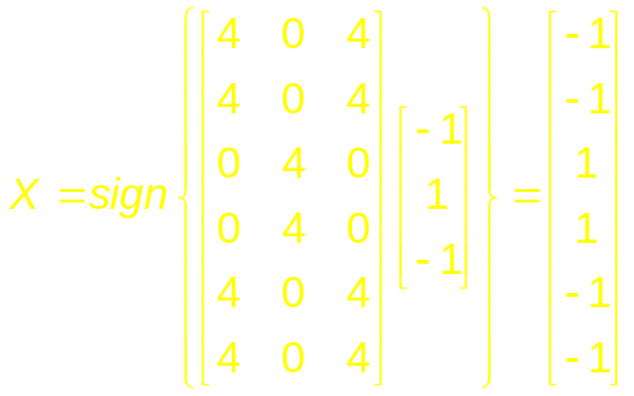
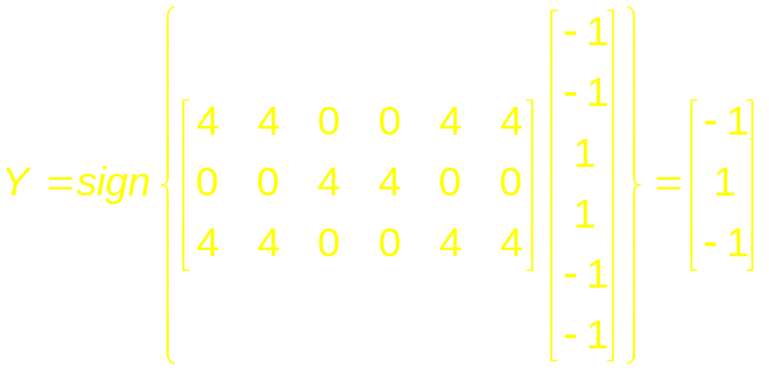
BAM Example
Step 3: Retrieval
X = (-1, 1, 1, 1, 1, -1)
JST - Bidirectional Associative Memory

Slide 23
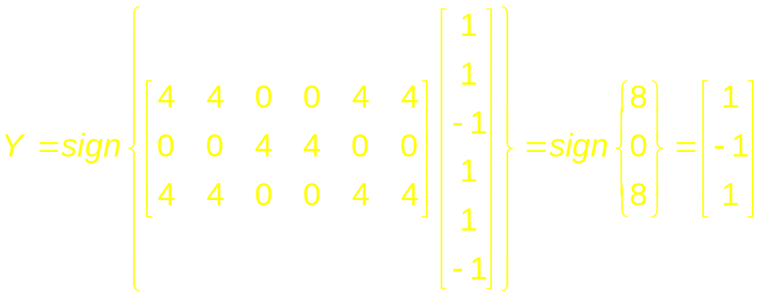
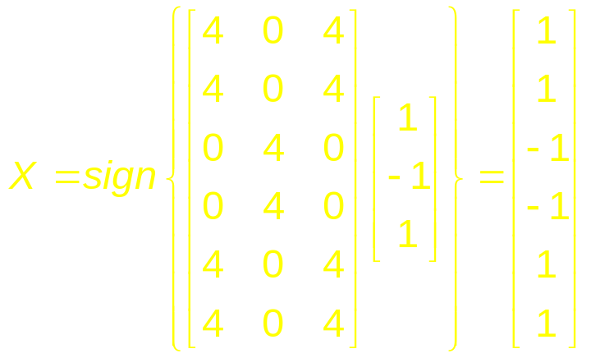
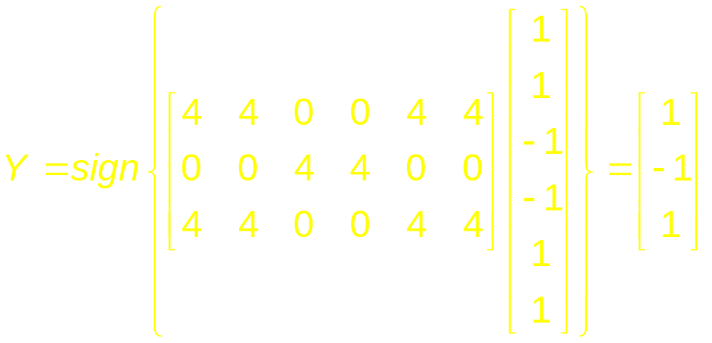
BAM Example
Step 3: Retrieval
X = (1, 1, -1, 1, 1, -1)
JST - Bidirectional Associative Memory

Slide 24
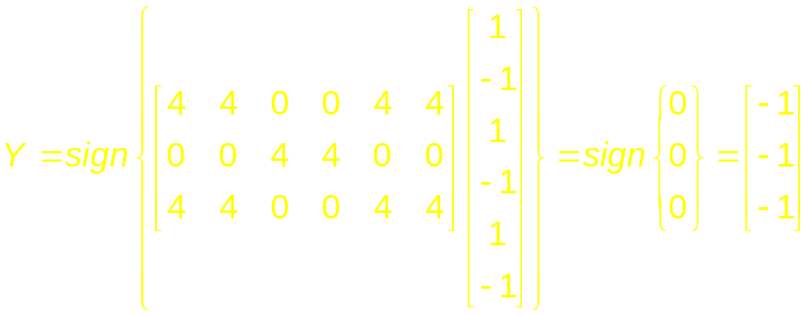
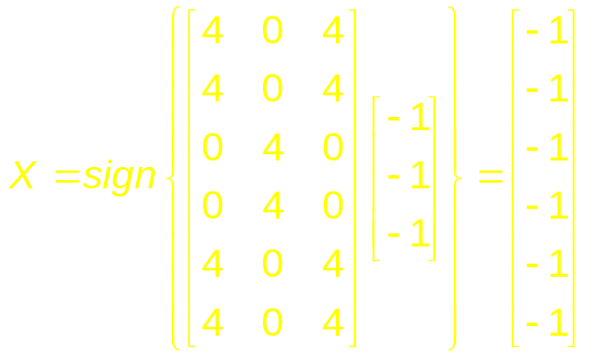
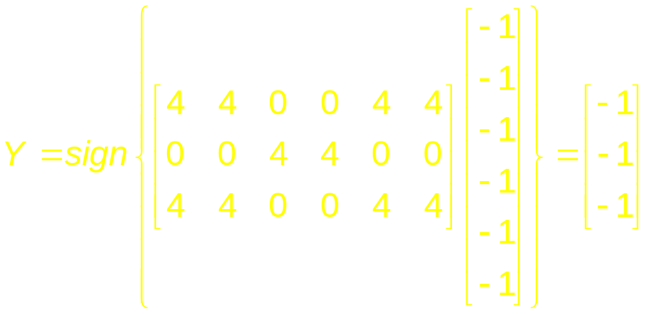
BAM Example
Step 3: Retrieval
X = (1, -1, 1, -1, 1, -1)
JST - Bidirectional Associative Memory

Slide 25
Bidirectional Associative Memory
BAM is capable of error correction.
BAM Limitation:
  The maximum number of associations to be stored should not exceed the number of neurons in the smaller layer.
  Can stop incorrect convergence.
  May not always produce the closest association (incorrect convergence)
However, despite all its problems and limitations, the BAM promises to become one of the most useful artificial neural networks.
JST - Bidirectional Associative Memory

Slide 26
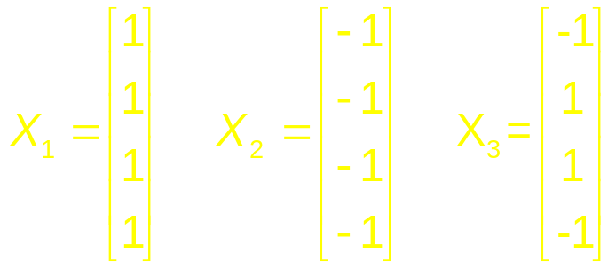
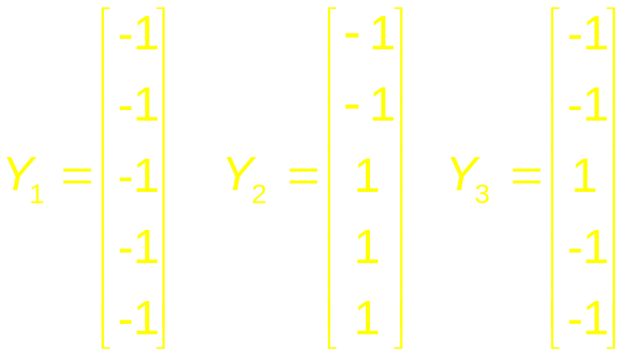
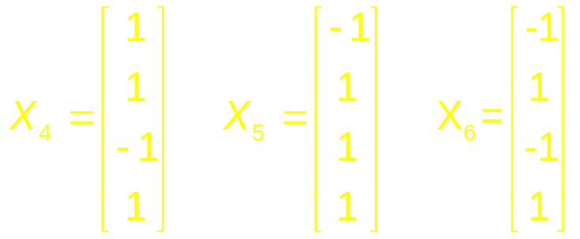
BAM Exercise
3 pattern (12 Point)
Set A:
Set B:
Retrieval Set:
JST - Bidirectional Associative Memory

